Slide 1
Resource and Task Assignments
Microsoft Project 2016
Lesson 3

Slide 2
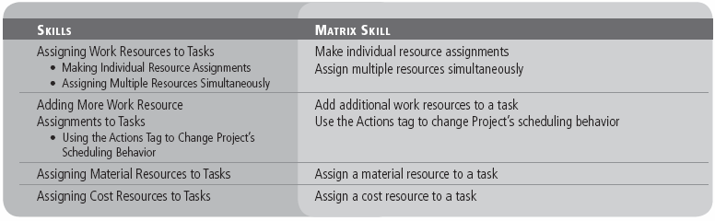
Objectives

Slide 3
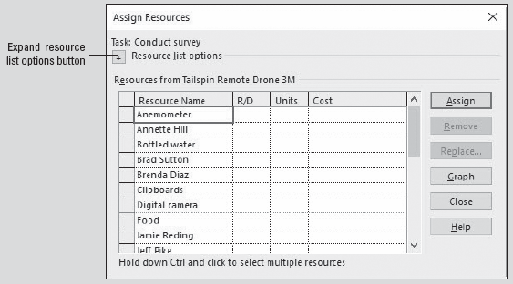
Software Orientation
In Microsoft Project, you can assign resources to a task using the Assign Resources dialog box, shown here.
You activate the Assign Resources dialog box via the Assign Resources button located in the Assignments group on the Resource ribbon.
Notes:
Assign Resources dialog box with Resource List options collapsed

Slide 4
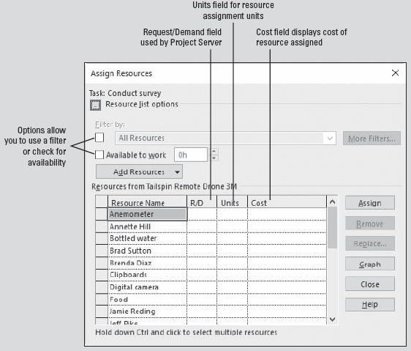
Software Orientation
The Assign Resources dialog box looks like the figure shown at right if the Resource List options are expanded.
The figure on the previous slide shows the Assign Resources dialog box with the Resource List options collapsed.
Notes:
Assign Resources dialog box with Resource List options expanded

Slide 5
Software Orientation
You can expand the Resource List options in the Assign Resources dialog box by clicking on the button marked with a plus sign next to the Resource List options heading.
You can collapse the expanded list by clicking the button, now marked with a minus sign, once again.
In this lesson, you will use the Assign Resources dialog box and other methods to assign resources.

Slide 6
Making Individual Resource Assignments
Microsoft Project provides you with various options for assigning resources to tasks. You can assign individual resources to a task or multiple resources to a task at one time.
Once assigned, you can track the resource working on the task. Microsoft Project also enables you to see whether or not resource assignments affect task duration.
An assignment is the matching of a specific resource to a particular task, to either perform work or as a material or a cost.
In the previous lessons, you mapped out tasks and resources for your project schedule. In the following exercise, you will learn how to assign work resources to the tasks they will perform.

Slide 7
Step-by-Step: Make Individual Resource Assignments
GET READY. Before you begin these steps, open Tailspin Remote Drone 3M from the data files for this lesson. SAVE the file as Tailspin Remote Drone 3.
Click the Resource tab. In the Assignments group, click the Assign Resources button. The Assign Resources dialog box appears.
If the Assign Resources dialog box is covering the Task Name column, drag the dialog box into the middle of the screen. Your screen should look similar to the figure shown on the next slide.
In the Task Name column of the Gantt Chart view, click the name of task 5, Develop survey questionnaire.
Notes:
Take Note: You can also assign resources via the Resources tab in the Task Information dialog box. To access this dialog box, double‐click on the task you want to assign resources.

Slide 8
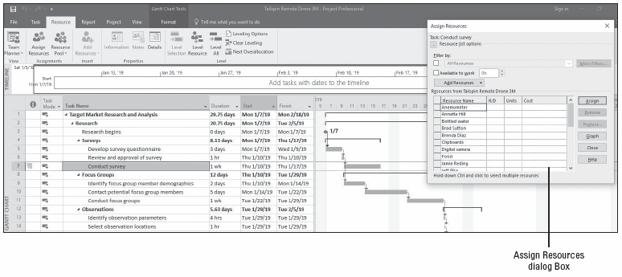
Step-by-Step: Make Individual Resource Assignments
Notes:
Gantt Chart view with Assign Resources dialog box open

Slide 9
Step-by-Step: Make Individual Resource Assignments
In the Resource Name column of the Assign Resources dialog box, scroll down, click Scott Seely, and then click the Assign button. In the Assign Resources dialog box, a check mark appears next to Scott Seely’s name, indicating that you have assigned him to the task of developing the survey questionnaire. Your screen should look similar to the figure shown on the next slide.
In the Task Name column, click the name of task 6, Review and approval of survey.
In the Assign Resources dialog box, click Jeff Pike and then click the Assign button. A check mark appears next to Jeff’s name to show that you have assigned him to task 6.
SAVE the project schedule.
PAUSE. LEAVE the project schedule open to use in the next exercise.
Notes:
Take Note: Resources are sorted alphabetically in the Assign Resources dialog box. Once the resource has been assigned, it is moved to the top of the list.

Slide 10
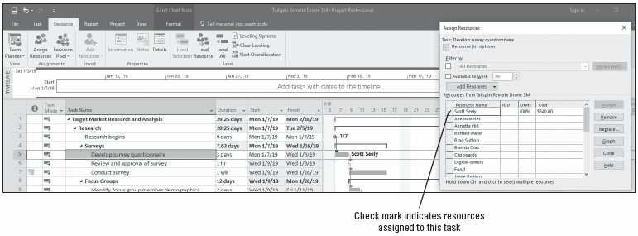
Step-by-Step: Make Individual Resource Assignments
Notes:
Gantt chart showing Scott Seely assigned

Slide 11
Assigning Multiple Resources Simultaneously
You have just assigned one resource to a task. In the following exercise, you will practice assigning multiple resources simultaneously to a task.
You might have noticed that the duration of task number 7 changed from 1 week to 1.2 weeks when you assigned Scott and Judy to the task. Bear in mind that Microsoft Project uses the resource calendars to schedule tasks when resources are assigned. The duration is extended by .2 weeks (1 day) due to the fact that Scott works Monday thru Thursday. The start and finish dates of the task did not change, however. This is due to effort‐driven scheduling being turned off. You will learn more about that later in this lesson.

Slide 12
Assigning Multiple Resources Simultaneously
The capacity of a resource to work when you assign that resource to a task is measured in units. Units are recorded in the Max. Units field in the Resource Sheet view. One full‐time resource has 100% (or 1.0) resource units.
As you are assigning resources, be careful that you do not overallocate a resource, by assigning it more work than can be done within the normal work capacity of the resource.
This might happen if you assign a resource to a task with more units than the resource has available. Another possibility is that you assign the resource to multiple tasks with schedules that overlap and with combined units that exceed those of the resource.
Notes:
Keep in mind that Microsoft Project assumes that all of a resource’s work time can be allotted to an assigned task unless you specify otherwise. If the resource has less than 100% maximum units, Microsoft Project assigns the value of the resource’s maximum units.

Slide 13
Step-by-Step: Assign Multiple Resources Simultaneously
GET READY. Use the Tailspin Remote Drone 3 project schedule you saved in the previous exercise.
In the Task Name column, click the name of task 7, Conduct survey.
In the Assign Resources dialog box, scroll down and click the name cell for Scott Seely. Scroll up or down in the list until the name Judy Lew is visible. Hold down the Ctrl key and then click the name cell for Judy Lew.
Release the Ctrl key and then click the Assign button. Check marks appear next to the names of Scott Seely and Judy Lew, indicating you have assigned them both to task 7.
Close the Assign Resources dialog box.
Notes:
Take Note: If you want to remove or unassign a resource from a task in the Assign Resources dialog box, click the resource you want removed and then click the Remove button.

Slide 14
Step-by-Step: Assign Multiple Resources Simultaneously
Move the center divider to the right to allow the Resource Names column to be visible.
Click once on the Resource Names cell for task 9, Identify focus group member demographics. Then click the submenu arrow at the right of the cell.
In the drop‐down list, select the Jeff Pike and Yan Li check boxes. Your screen should look similar to the figure shown on the next slide.
Press Enter.
SAVE the project schedule.
PAUSE. LEAVE the project schedule open to use in the next exercise.
Notes:
Take Note: Recall that in Lesson 2, you learned that Max. Units referred to the maximum capacity of a resource to accomplish tasks.

Slide 15
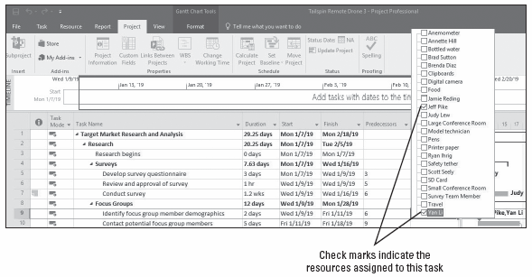
Step-by-Step: Assign Multiple Resources Simultaneously
Notes:
Assigning resources using the drop‐down list in the Resource Names column

Slide 16
Adding More Work Resource Assignments to Tasks
Microsoft Project’s default method of scheduling is considered non‐effort‐driven. This means that as you assign resources to a task, the duration remains constant and the work value is calculated.
The most obvious effect of this scheduling method is that, as you add or remove resources, the work value changes and, therefore, the costs change.
Work is the total amount of effort expended to complete a task. Microsoft Project calculates work using a work formula:
Work = Duration × Units.
Although you have the option of entering and displaying work in different units, by default, work is expressed in hours.
Notes:
You have started to define resource assignments for several tasks in your project schedule. In the following exercise, you will assign additional resources to those tasks. To view work information in each task, you will use a split view. Pay close attention to the results in relation to task duration and work in the split view.

Slide 17
Step-by-Step: Add Work Resources to a Task
GET READY. Use the Tailspin Remote Drone 3 project schedule you saved in the previous exercise.
Click the View tab. On the ribbon, in the Split View group, select the Details check box. The Task Form view appears in the bottom part of your screen.
Click the name of task 5, Develop survey questionnaire. In the Task Form pane at the bottom of your screen, note the Work value of this task—24 hours.
In the Task Form view, click once on the first cell below Scott Seely’s name. Click the submenu arrow at the right of this cell and then select Jeff Pike.
Notes:
Take Note: Notice that when you added Jeff to task 5, Microsoft Project calculated his work using the formula above. Jeff’s schedule is 5 days/week, 8 hours/day and the task was three days in duration (or 3 days @ 8 hours each day). Therefore, Work = 24 hours of duration * 1 full‐time resource = 24 hours of work. The total work of the task doubled with the addition of this one resource. Notice also that Project automatically highlighted the duration, which changed as a result of adding Jeff, based on his work schedule.

Slide 18
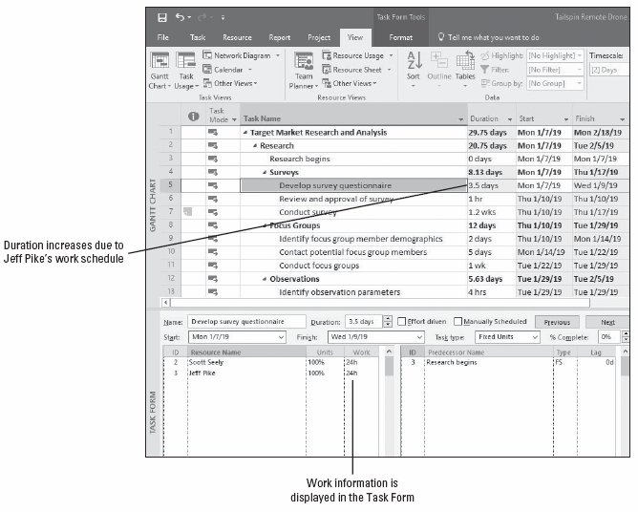
Step-by-Step: Add Work Resources to a Task
At the top of the Task Form, click OK. Microsoft Project assigns Jeff Pike to task 5. Your screen should look similar to the figure shown here.
SAVE the project schedule.
PAUSE. LEAVE the project schedule open for the next exercise.
Notes:
Split window view with Gantt Chart (top) and Task Form (bottom) views

Slide 19
Step-by-Step: Add Work Resources to an Effort-Driven Task
GET READY. Use the Tailspin Remote Drone 3 project schedule you saved in the previous exercise.
Click on the name of task 9, Identify focus group member demographics. Jeff Pike and Yan Li are currently assigned to this task, total work is calculated at 32 hours (16 hours per resource), and the duration is 2 days. You’d like to assign an additional resource and reduce the task’s duration.
In the Task Form screen, click the Effort driven check box.
Click once in the blank cell below Yan Li’s name. From the drop‐down menu, select Brenda Diaz. Then click OK at the upper portion of the Task Form screen. Your screen should look similar to the figure on the next slide.
Notes:
Take Note: Although effort‐driven scheduling is not the default for tasks you create in Microsoft Project, you can change this setting for all new tasks in a project schedule. On the ribbon bar, click File and then select Options. In the Project Options dialog box, select Schedule. Navigate down to Scheduling options for this project and clear or select the New tasks are effort driven check box. To change effort‐driven scheduling for a single task or group of tasks, select the desired task(s). Click the Task ribbon and then in the Properties group, select the Information button. Select the Advanced tab of the Multiple Task Information dialog box. Clear or select the Effort driven check box.

Slide 20
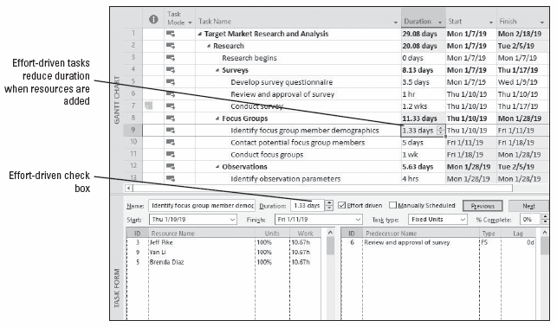
Step-by-Step: Add Work Resources to an Effort-Driven Task
Notes:
Addition of a resource to task 9 resulting in less duration

Slide 21
Step-by-Step: Add Work Resources to an Effort-Driven Task
Notice that the duration has been changed to 1.33 days and the total work (32 hours) has now been evenly distributed between Jeff Pike and Brenda Diaz. In this instance, you applied effort‐driven scheduling, which tells Microsoft Project to hold the work value constant and change the duration when resources are added or removed.
SAVE the project schedule.
PAUSE. LEAVE the project schedule open to use in the next exercise.
Notes:
Similar to the work formula and in the context of duration, the duration formula is used in effort‐driven scheduling. The formula is Duration = Work/Units. In an effort‐driven task, the work value is held steady and the variable is units. In the example you used in the previous exercise, 160 hours was the work value with one resource assigned. When you assigned Brenda Diaz to the task (another full‐time resource), the duration formula was applied as:
Duration = 32/3 = 10.67. So, Duration = 10.67 hours or 1.33 days of working time.

Slide 22
Using the Actions Tag to Change Project’s Scheduling Behavior
Now that you have assigned resources to tasks that are both effort‐driven and non‐effort-driven, in the next exercise, you will learn how to use the Actions tag to change how Project behaves.
An Actions tag is an indicator that signals the user of a change, additional information, formatting options, and so forth.
In Project 2016, the Actions tag appears mainly when changes to units, duration, or work occurs. The Actions tag will appear only when certain methods are used to apply changes, such as adding resources with the Assign Resources dialog box. The Actions tag only remains available until you perform your next action.

Slide 23
Step-by-Step: Use the Actions Tag to Change Project’s Scheduling Behavior
GET READY. Use the Tailspin Remote Drone 3 project schedule you saved in the previous exercise.
In the Gantt chart portion of the view, click on the name of task 5, Develop survey questionnaire. You’d like to assign an additional resource and reduce the task’s duration.
Click the Resource tab. In the Assignments group, click the Assign Resources button. The Assign Resources dialog box appears.
In the Resource Name column, click Annette Hill. Hold down the Ctrl key and then locate and click Brad Sutton. Release the Ctrl key.
Click the Assign button. These two resources are added to the task. An Actions tag appears to the left of the Task Name column.
Click the Actions tag button. A list of options regarding how you want to handle this additional resource is displayed. Your screen should look similar to the figure on the next slide.
Notes:
Take Note: Microsoft Project will only display the Actions tag under certain circumstances. For example, if you assigned resources in the Task Form on an effort‐driven task, the Actions tag would not appear in the Gantt chart portion of the view.

Slide 24
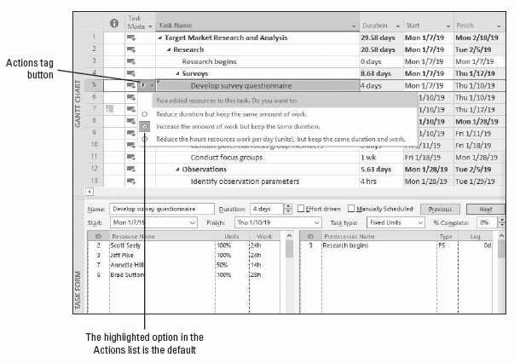
Step-by-Step: Use the Actions Tag to Change Project’s Scheduling Behavior
Notes:
Actions tag options list

Slide 25
Step-by-Step: Use the Actions Tag to Change Project’s Scheduling Behavior
Select Reduce duration but keep the same amount of work.
Click the name of task 7, Conduct survey. Notice in the Task Form screen that the Effort driven check box is not checked for this task. Take note of the work data in the Task Form pane (80 hours total).
In the Resource Name column of the Assign Resources dialog box, click Annette Hill.
Scroll down until Ryan Ihrig’s name is visible. Hold down Ctrl and click Ryan Ihrig. Release the Ctrl key and then click the Assign button. Microsoft Project assigns Annette and Ryan to the task.

Slide 26
Step-by-Step: Use the Actions Tag to Change Project’s Scheduling Behavior
Because this task is using the default settings, Microsoft Project increases the total work value and keeps the task duration constant. However, you have determined that this task does not require a full‐time effort because these two additional resources will take over some of the administrative functions.
Click the Actions tag button. Select Reduce the hours resources work per day (units), but keep the same duration and work. Your screen should look similar to the figure shown on the next slide.
Microsoft Project calculates the work values for each resource, keeps the task’s duration at 1.2 weeks, and adjusts the units for each resource.

Slide 27
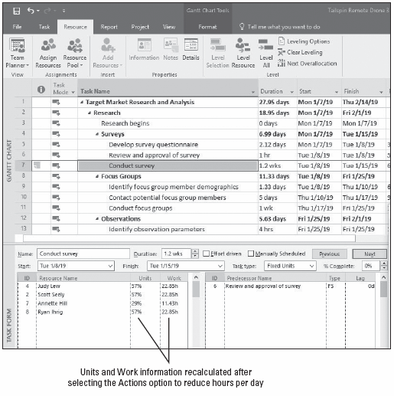
Step-by-Step: Use the Actions Tag to Change Project’s Scheduling Behavior
Click the Close button in the Assign Resources dialog box.
SAVE the project schedule.
PAUSE. LEAVE the project schedule open to use in the next exercise.
Notes:
Split view showing details of task information after a resource addition

Slide 28
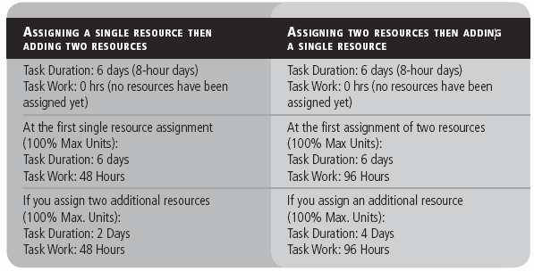
Using the Actions Tag to Change Project’s Scheduling Behavior
Using effort‐driven scheduling, Microsoft Project maintains a work amount as the total effort required to perform a task until you change it. Project performs the work calculation at the first work resource assignment, regardless of the number of resources assigned. The table shows an example using the same task duration and different approaches of assigning the same resources.
Notes:
Varying approaches to assigning the same total number of resources

Slide 29
Using the Actions Tag to Change Project’s Scheduling Behavior
If you have one resource working full‐time on a task, the amount of work will match the duration. If your resource is not working full‐time, or if you assign more than one resource to a task, then work and duration will not be equal.
You can now see the benefit of creating task relationships rather than setting start or finish dates. Because effort‐driven scheduling results in decreased task durations, Microsoft Project adjusts the start dates of successor tasks that did not have a constraint such as a start or finish date.
Remember that effort‐driven scheduling adjusts task duration only if you add or delete resources from a task. Whether or not to use effort‐driven scheduling is a topic for discussion with your organization. It has both benefits and risks.
Notes:
Take Note: Exercise caution when determining the extent to which effort‐driven scheduling should apply to the tasks in your project. Although applying more resources to your tasks might reduce their duration on paper, this might not be possible in a real‐world situation. For example, if one resource could complete a task in 20 hours, could 20 resources complete the task in one hour? What about 40 resources in 30 minutes? In reality, the resources would probably get in each other’s way and productivity might even decrease because additional coordination might be needed. For complex tasks, a resource might need specialized training before he could be productive. There is no exact rule about when you should or should not apply effort‐driven scheduling. As a project manager, you need to review the requirements of your project tasks and use your best reasoning.

Slide 30
Assigning Material Resources to Tasks
When you assign a material resource to a task, there are two ways in which you can handle their consumption and cost:
Assign a fixed unit quantity of the material resource. This is what you did in the preceding exercise. Microsoft Project then multiplied the unit cost of the resource by the number of units to calculate the total cost.
Assign a variable rate quantity of the material resource. For example, if two cases of bottled water will be used per day, you would enter 2/day as the assignment unit. Microsoft Project will adjust the quantity and cost of the resource as the duration of the task changes. You will assign a material resource using this method in a later lesson.
Notes:
You will learn more about resource consumption rates in Lesson 6. In the following exercise, you will assign material resources to tasks. Most projects use at least some material resources.

Slide 31
Step-by-Step: Assign a Material Resource to a Task
GET READY. Use the Tailspin Remote Drone 3 project schedule you saved in the previous exercise.
In the Task Name column, click the name of task 7, Conduct survey.
Click the Resource tab. In the Assignments group, click the Assign Resources button. The Assign Resources dialog box appears.
In the Assign Resources dialog box, click once in the Units field for the Bottled water. Key 2 and then click the Assign button.

Slide 32
Step-by-Step: Assign a Material Resource to a Task
If the Assign Resources dialog box is covering the scroll bars for the Gantt bar portion of your screen, drag the dialog box into the middle of the screen.
Scroll the Gantt bar portion of your screen so that the right end of the bar for task 7 is visible. You will use 2 cases of bottled water while conducting the survey.
Remember that bottled water is a material resource and cannot do work, so assigning it to a task does not affect the task’s duration. Your screen should look similar to the figure on the next slide.

Slide 33
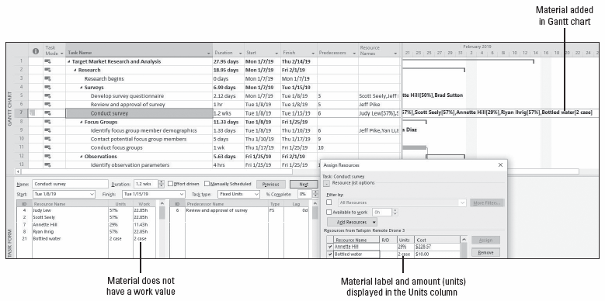
Step-by-Step: Assign a Material Resource to a Task
Notes:
Bottled water resource added to task 7

Slide 34
Step-by-Step: Assign a Material Resource to a Task
In the Assign Resources dialog box, click Close.
SAVE the project schedule.
PAUSE. LEAVE the project schedule open to use in the next exercise.

Slide 35
Assigning Cost Resources to Tasks
A cost resource is another type of resource that you can assign to a task.
A cost resource represents a financial obligation to your project.
Once you assign the cost resource to the task, you can then assign the cost for the resource.
In the following exercise, you will assign cost resources to two different tasks.

Slide 36
Step-by-Step: Assign a Cost Resource to a Task
GET READY. USE the Tailspin Remote Drone 3 project schedule you saved in the previous exercise.
On the Resource tab, in the Assignments group, click the Assign Resources button. The Assign Resources dialog box appears.
Scroll up or down in the Gantt view and in the Task Name column, click the name of task 11, Conduct focus groups.
In the Resource Name column of the Assign Resources dialog box, click Food and then click the Assign button.

Slide 37
Step-by-Step: Assign a Cost Resource to a Task
In the Cost column for the Food resource, key 500 and press Enter. During the focus groups activity, $500 of food will be used to feed the people who will participate in the focus group.
Click the name of task 15, Conduct observations.
In the Resource Name column of the Assign Resources dialog box, click Food and then click the Assign button.
In the Cost column for the Food resource, key 500 and press Enter. Your screen should look like the figure on the next slide.

Slide 38
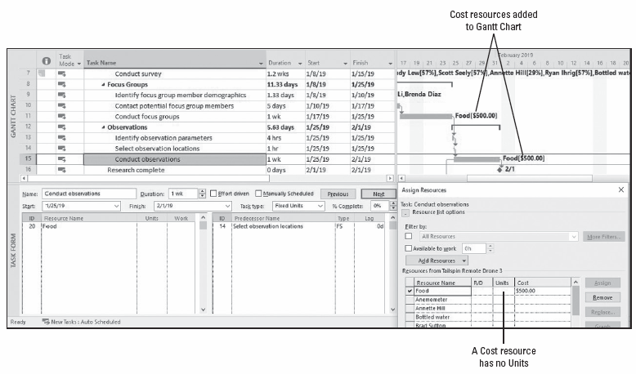
Step-by-Step: Assign a Cost Resource to a Task
Notes:
Cost resources added to tasks 11 and 15

Slide 39
Step-by-Step: Assign a Cost Resource to a Task
In the Assign Resources dialog box, click Close.
SAVE and CLOSE the Tailspin Remote Drone 3 file.
PAUSE. If you are continuing to the next lesson, keep Microsoft Project open. If you are not continuing to additional lessons, CLOSE Microsoft Project.

Slide 40
Skill Summary

